Slide 1
Convolutional Neural Networks
Training at Dell RMZ

Slide 2

Buzz…

Slide 3

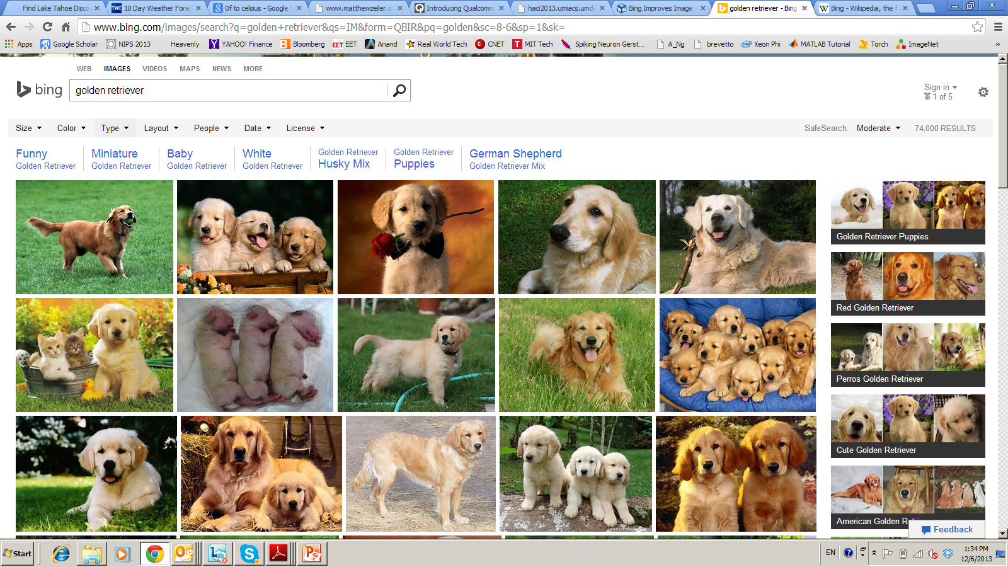



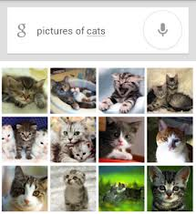

Deep Learning – from Research to Technology
Deep Learning - breakthrough in visual and speech recognition

Slide 4
Deep Learning Basics
Deep Learning – is a set of machine learning algorithms based on multi-layer networks
CAT
DOG
OUTPUTS
HIDDEN
NODES
INPUTS

Slide 5



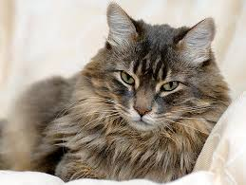
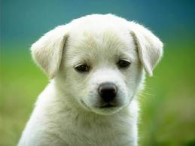

Deep Learning Basics
Deep Learning – is a set of machine learning algorithms based on multi-layer networks
CAT
DOG
Training

Slide 6

Deep Learning Basics
Deep Learning – is a set of machine learning algorithms based on multi-layer networks
CAT
DOG

Slide 7
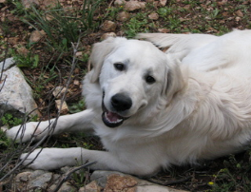
Deep Learning Basics
Deep Learning – is a set of machine learning algorithms based on multi-layer networks
CAT
DOG

Slide 8
Deep Learning Taxonomy
Supervised:
Convolutional NN ( LeCun)
Recurrent Neural nets (Schmidhuber )
Unsupervised
Deep Belief Nets / Stacked RBMs (Hinton)
Stacked denoising autoencoders (Bengio)
Sparse AutoEncoders ( LeCun, A. Ng, )

Slide 9
Convolutional Networks

Slide 10
Convolutional NN
Convolutional Neural Networks is extension of traditional Multi-layer Perceptron, based on 3 ideas:
Local receive fields
Shared weights
Spatial / temporal sub-sampling or Pooling
See LeCun paper (1998) on text recognition:
http://yann.lecun.com/exdb/publis/pdf/lecun-01a.pdf

Slide 11
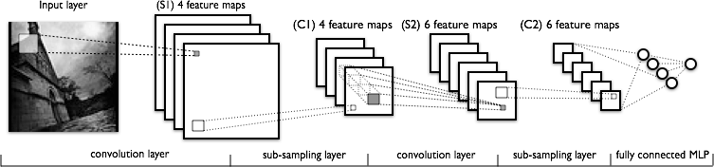
What is Convolutional NN ?
CNN - multi-layer NN architecture
Convolutional + Non-Linear Layer
Sub-sampling Layer or Pooling layer
Convolutional +Non-Linear Layer
Fully connected layers
Supervised
Feature Extraction
Classi-
fication

Slide 12
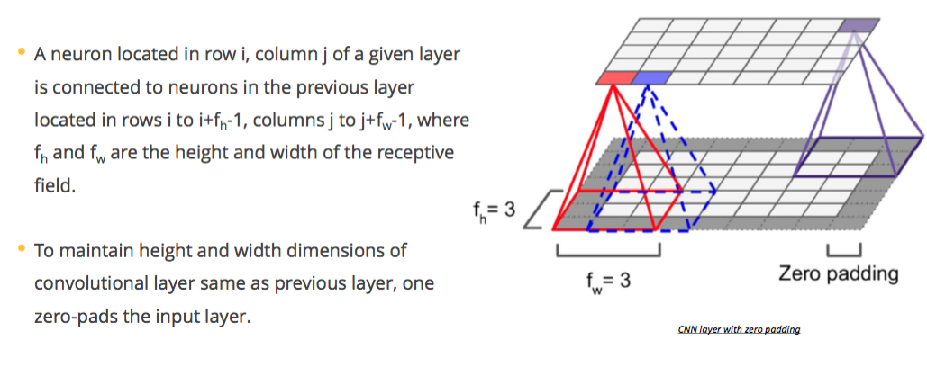
Receptive field and padding

Slide 13
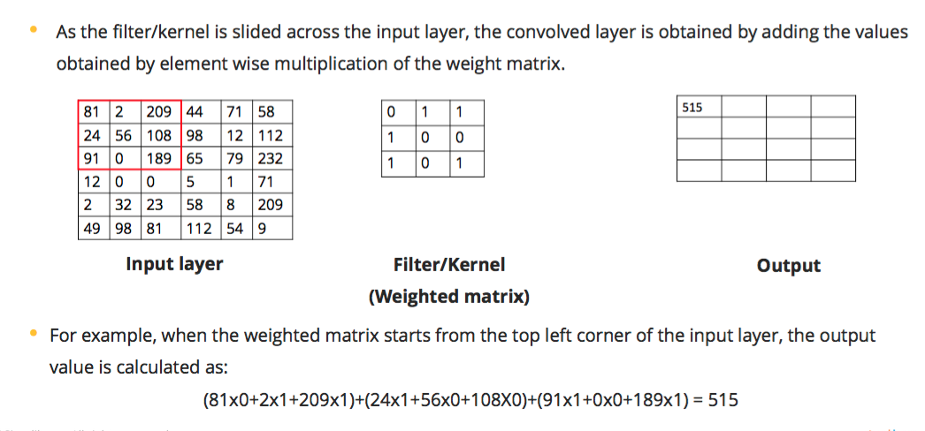
Convolution operation

Slide 14
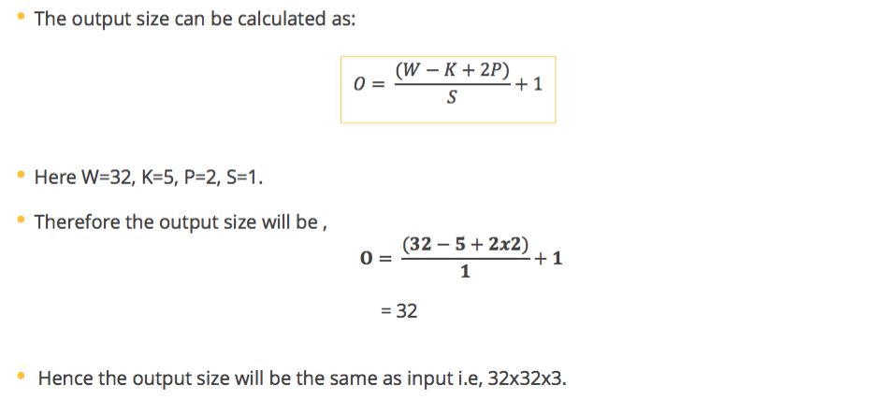
Conv operation – filter size, stride and padding

Slide 15

What is Convolutional NN ?
2x2
Convolution + NL
Sub-sampling
Convolution + NL

Slide 16

CNN success story: ILSVRC 2012
Imagenet data base: 14 mln labeled images, 20K categories

Slide 17
Imagenet 2013: top rankers
http://www.image-net.org/challenges/LSVRC/2013/results.php
N | Error-5 | Algorithm | Team | Authors
1 | 0.117 | Deep Convolutional Neural Network | Clarifi | Zeiler
2 | 0.129 | Deep Convolutional Neural Networks | Nat.Univ Singapore | Min LIN
3 | 0.135 | Deep Convolutional Neural Networks | NYU | Zeiler Fergus
4 | 0.135 | Deep Convolutional Neural Networks |  | Andrew Howard
5 | 0.137 | Deep Convolutional Neural Networks | Overfeat NYU | Pierre Sermanet et al

Slide 18
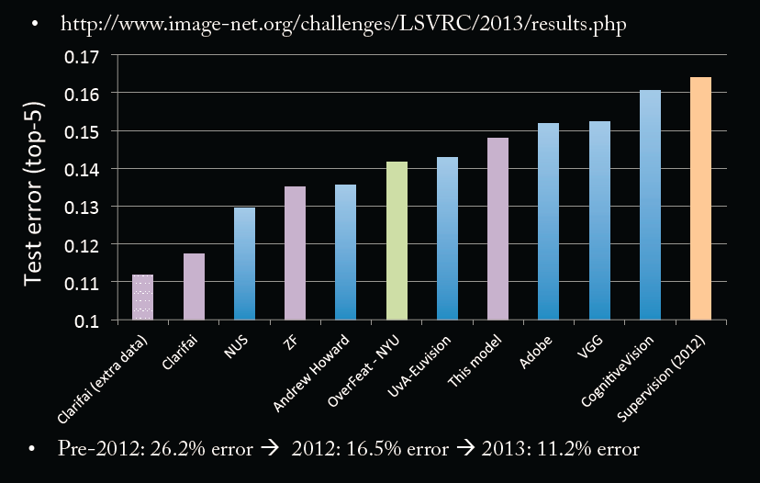
Imagenet Classifications 2013

Slide 19
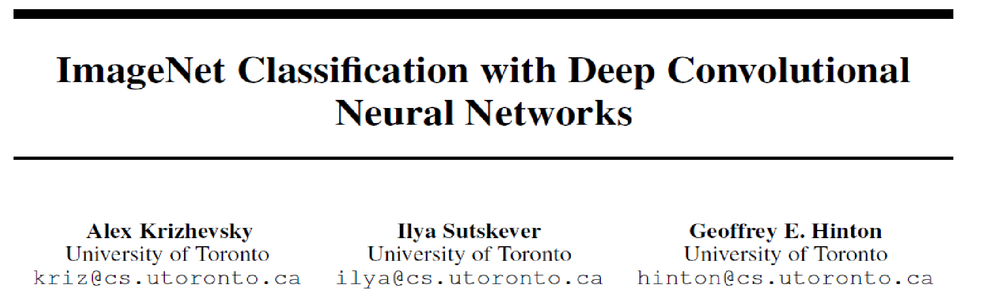
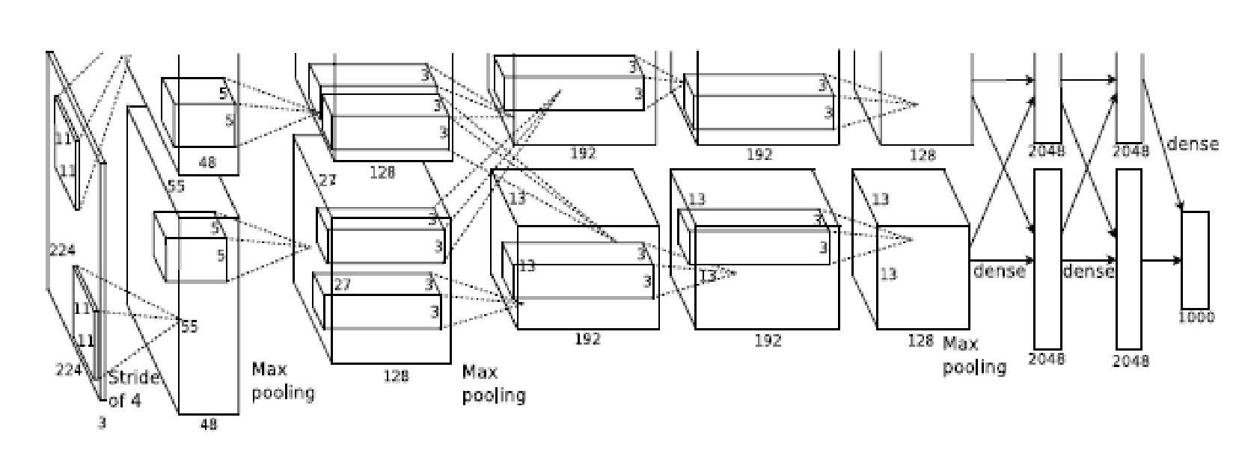
Conv Net Topology
5 convolutional layers
3 fully connected layers + soft-max
650K neurons , 60 Mln weights

